Slide 1

Challenge: Analysing Historical IPL data and provide insights on IPL 2024 for a sports magazine
Problem Statement
"Sports Basics" is a sports blog company that entered space recently. They wanted to get more traffic to their website by
releasing a special edition magazine on IPL 2024. This magazine aims to provide interesting insights and facts for fans,
analysts and teams based on the last 3 years' data.

Slide 2

DATASETS AVAILABLE
This document contains all the meta information regarding the columns described in the CSV files for a comprehensive analysis of IPL matches over the past three years (2021, 2022, 2023). We have provided 4 CSV files:
1. dim_match_summary
2. fact_batting_summary
3. fact_bowling_summary
4. dim_players
TOOLS USED BY ME :
EXCEL
POWERBI

Slide 3
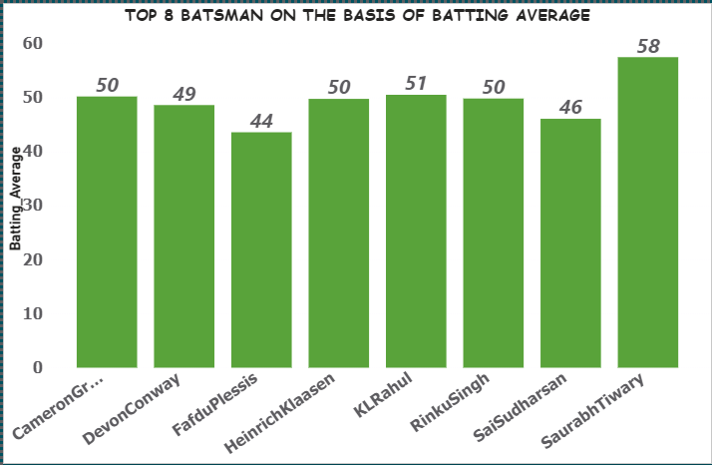
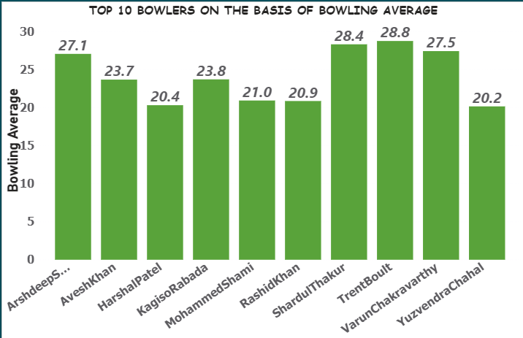
PRIMARY INSIGHTS

Slide 4

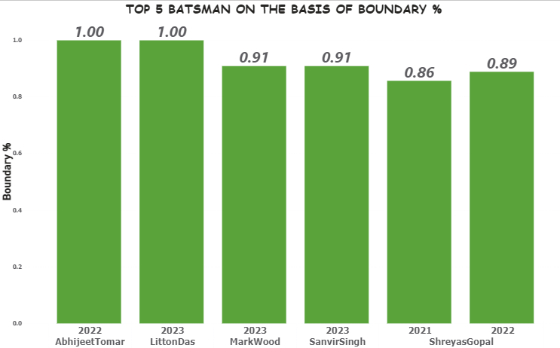
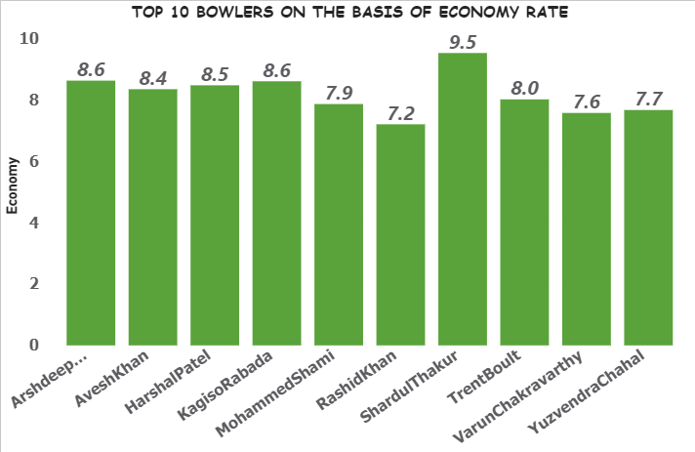
PRIMARY INSIGHTS

Slide 5
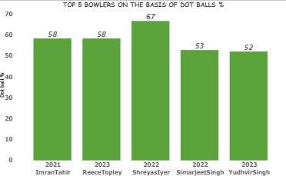
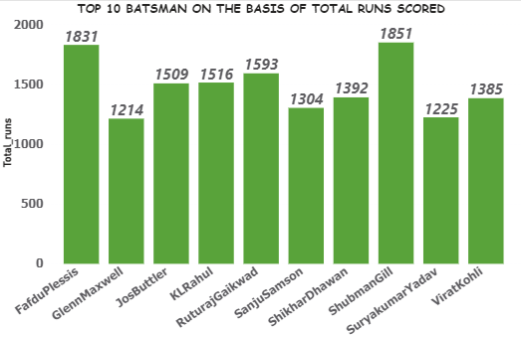
PRIMARY INSIGHTS

Slide 6
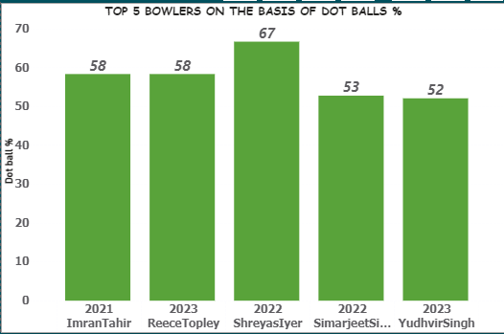
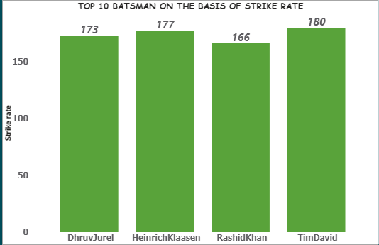
PRIMARY INSIGHTS

Slide 7
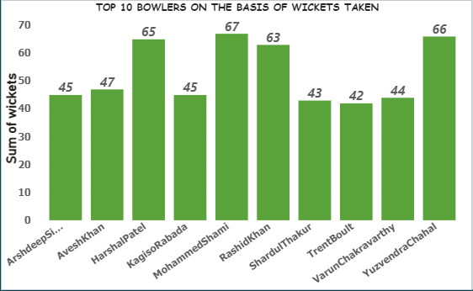
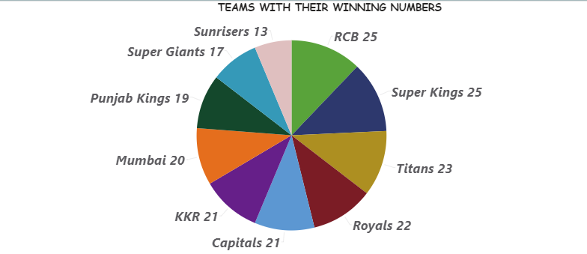
PRIMARY INSIGHTS

Slide 8


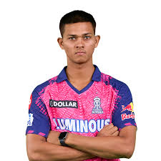



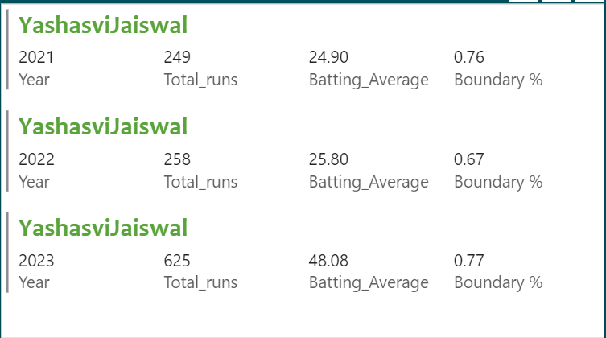
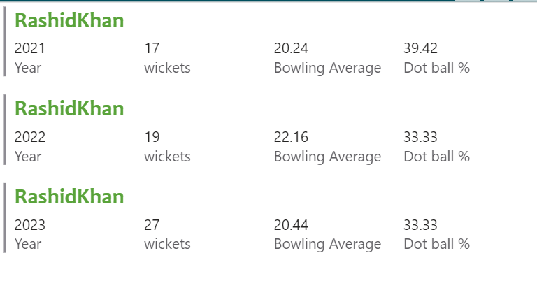
SECONDARY INSIGHTS
ORANGE CAP/PURPLE CAP PLAYERS

Slide 9



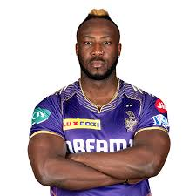


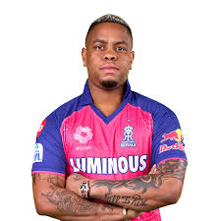

SECONDARY INSIGHTS
SUPER 11
NAME
SHUBHMAN GILL
TEAM
KKR
NAME
SANJU SAMSON
TEAM
ROYALS
NAME
DAVID MILLER
TEAM
ROYALS
NAME
ANDRE RUSSEL
TEAM
KKR
NAME
FAFDU PLESSIS
TEAM
SUPER KINGS
NAME
TEAM
MUMBAI
SURYA KUMAR YADAV
NAME
SHIMRON HETMAYER
TEAM
CAPITALS
NAME
TILAK VERMA
TEAM
MUMBAI

Slide 10


SECONDARY INSIGHTS
SUPER 11
NAME
RASHID KHAN
TEAM
SUNRISERS
NAME
MOHSIN KHAN
TEAM
SUPER GIANTS
NAME
MARKWOOD
TEAM
SUPER GIANTS

Slide 11



PREDICTIVE ANALYSIS
TOP 4 TEAMS IN 2024
WINNER 2024
RUNNER UP 2024

Slide 12
THANK YOU!!
I WOULD LIKE TO EXPRESS MY GRATITUDE TO THE CODEBASICS TEAM FOR PROVIDING THIS RESUME CHALLENGE.

